Slide 1

Automated Online School Attendance Management System
5th Nov,
2019
Mobin.Muhammad@pgr.reading.ac.uk
Location: Karachi

Slide 2

Table Of Content
Slide 03 | Profile
Slide 05 | Objectives
Slide 06 | What is an RFID Attendance System?
Slide 07 | Helpful For Parents
Slide 08 | Benefits for the school
Slide 09 | Existing Approaches
Slide 13 | RFID Based Attendance Management Systems
Slide 17 | Workflow
Slide 20 | Key Features
Slide 28 | Models

Slide 3

Profile
FPRC
FIRST PRIVATE RESEARCH CENTER PAKISTAN

Slide 4
FPRC
FIRST PRIVATE RESEARCH CENTER PAKISTAN
Profile
We are the First Private Research Center in Pakistan focusing on Artificial Intelligence and Computer Vision Technologies. The objective of Research Institute is to fill the gap between the research and the people of Pakistan and bring the latest research opportunities. We deals in RFID (Radio Frequency Identification) products for school attendance systems)

Slide 5

Objectives
It makes education more fun
Attendance is an important everyday school activity. A decade ago, attendance was taken at schools by calling out everyone’s name.
Now, technology updates like Artificial Intelligence and Machine learning is reshaping the world.
RFID technology is currently the most popular and feasible technology used for School Attendance Systems

Slide 6

What is an RFID Attendance System?
An RFID attendance System uses RFID tags to log the attendance of individual students.
A database maintains a unique profiles for individual students with details such as their address, date of birth, class, etc. which can be viewed through school apps or parent portals.

Slide 7

Helpful For Parents
In the end, it all comes down to what your kid is comfortable with
Automatic Attendance: After installing the RFID devices, parents get automatic SMS notification when the child enters or leaves the school.
Communication: RFID system & software helps you to make a better communication system between student/ Parents & Teacher

Slide 8

Benefits for the school
Centralised: attendance system keeps track of student attendance across multiple campuses.
Reports: Generate attendance report in a single click.
RFID Card: We provide complete student RFID ID card.
SMS & Notification: You can send any information to a group of students or parents in a single click

Slide 9
Existing Approaches
Students Attendance Management System
(Key Challenges)

Slide 10
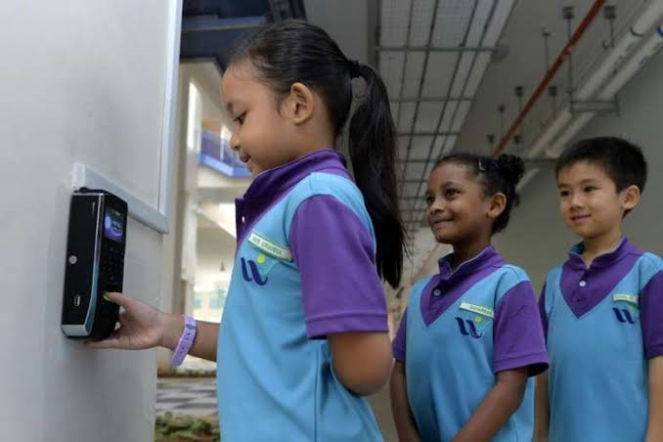
Fingerprint Attendance
Long Queues
(Why Its not Feasible)
Wrong positioning of the finger.
A typical throughput of
fingerprint scanner is 6–10
seconds ^{[1]}
Long Queues in the Morning
West Spring Primary School Singapore ^{[2]}
References
[1] www.sciencedirect.com/topics/computer-science/fingerprint-reader
[2] www.straitstimes.com/singapore/no-school-roll-call-kids-check-in-with-thumbs

Slide 11
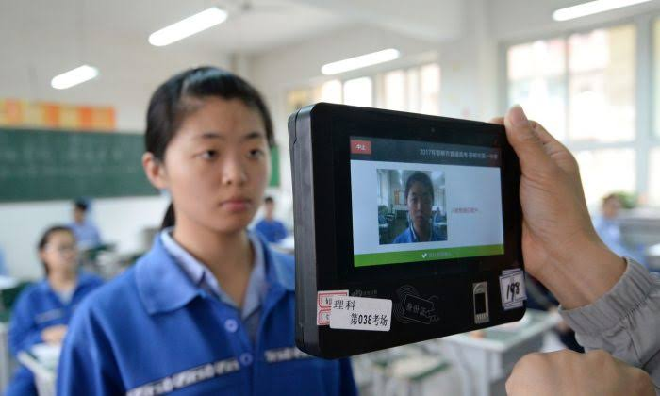
Face Recognition
(Why Its not Feasible)
Illumination: change in lighting conditions.
Background: A facial recognition system might not produce the same results outdoors compared to what it produces indoors due to change in background.
Pose: The movements of head can invariably cause changes in face appearance.
Occlusion: wearing caps, scarf, changes in hair style, accessories goggles, etc.
China: Facial recognition for student before in Hebei Province on June 6, 2017^{[1]}
References
[1] brandscovery.com/business/content-2252542-chinese-high-school-student-s-face-buys-lunch

Slide 12
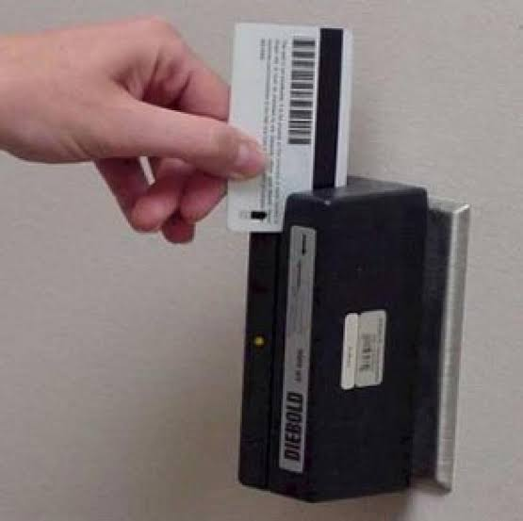
Swipe/Magnetic Card
(Why Its not Feasible)
Correct positioning of the card is difficult specially for the young children.
Time consuming.
Card can wear out due to use, and the data can be corrupted.
Kendriya Vidyalayas

Slide 13
RFID Based
RFID Based Attendance Management Systems
(Benefits)

Slide 14

Walkthrough Gates
Multiple card detection
Long range wireless RFID walkthrough.
Takes approximately 0.002 second, with 40 tags being readable in about 0.1 seconds.
Children are given RFID Cards which they can carry in their pocket, bags or worn around the neck.
Automatic SMS on their mobile phones as soon as their child Enters/Exits the school.
SECUREYE RFID WALK THROUGH STUDENT ATTENDANCE SYSTEM

Slide 15
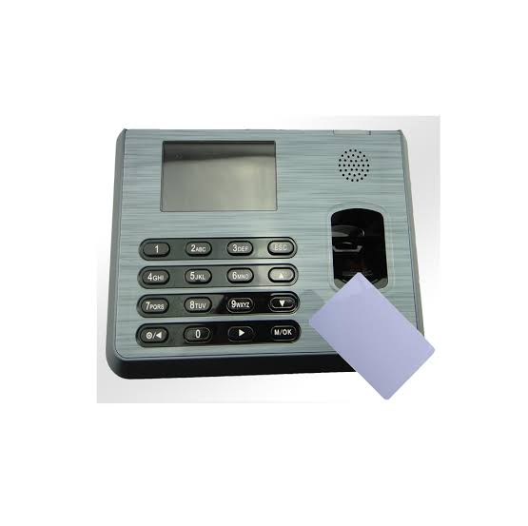
Why RFID in Schools ?
Existing Approaches
2 – RFID Attendance Machine
SMS feature is available in some models with limited options ( no SMS for students absent)
These devices are not online/real-time,
Stores data in SD memory which needs transfer to generate reports.
Manually Download/upload Student’s data in the device.
The cost of RFID card is around 50 to 60 PKR ^{[2]}
Existing RFID Card Attendance Machine ^{[1]}
References
[1] www.zkteco.com
[2] http://arduinopak.com/Search.aspx?Search_Term=RFID

Slide 16
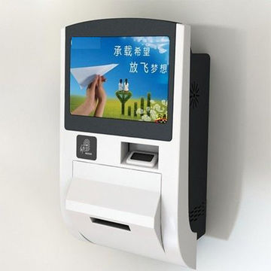

Our Approach
Sends SMS in case student is absent on a preconfigured time (default is 9:00 am)
Stores attendance log in SD memory and transfers to the Database server.
Download/upload Student’s data automatically in the device.
Visual indications on the device when student arrives late.
Time-in and Time-out can be configured according to each grade/class and sections.
Any android Phone can be used to enter the attendance data (in case a student forgets card).
Integration to existing school management systems to import student and teacher’s data.
Automated Online School Attendance Management System
RFID (Online)
IoT Webserver, SQL, SMS

Slide 17
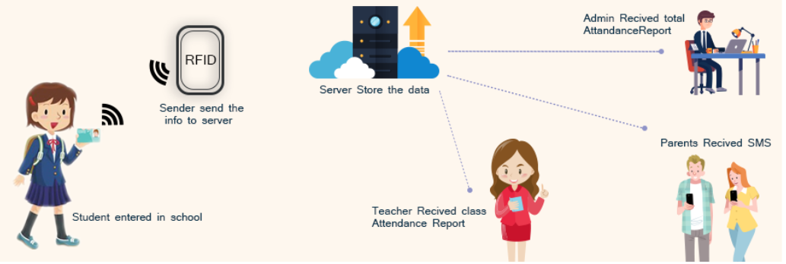
Workflow
Management Received total Attendance Report
Server Stores the data
Sender sends the info to server
Parents Received SMS
Student Entered in School
Teacher Received class Attendance Report

Slide 18



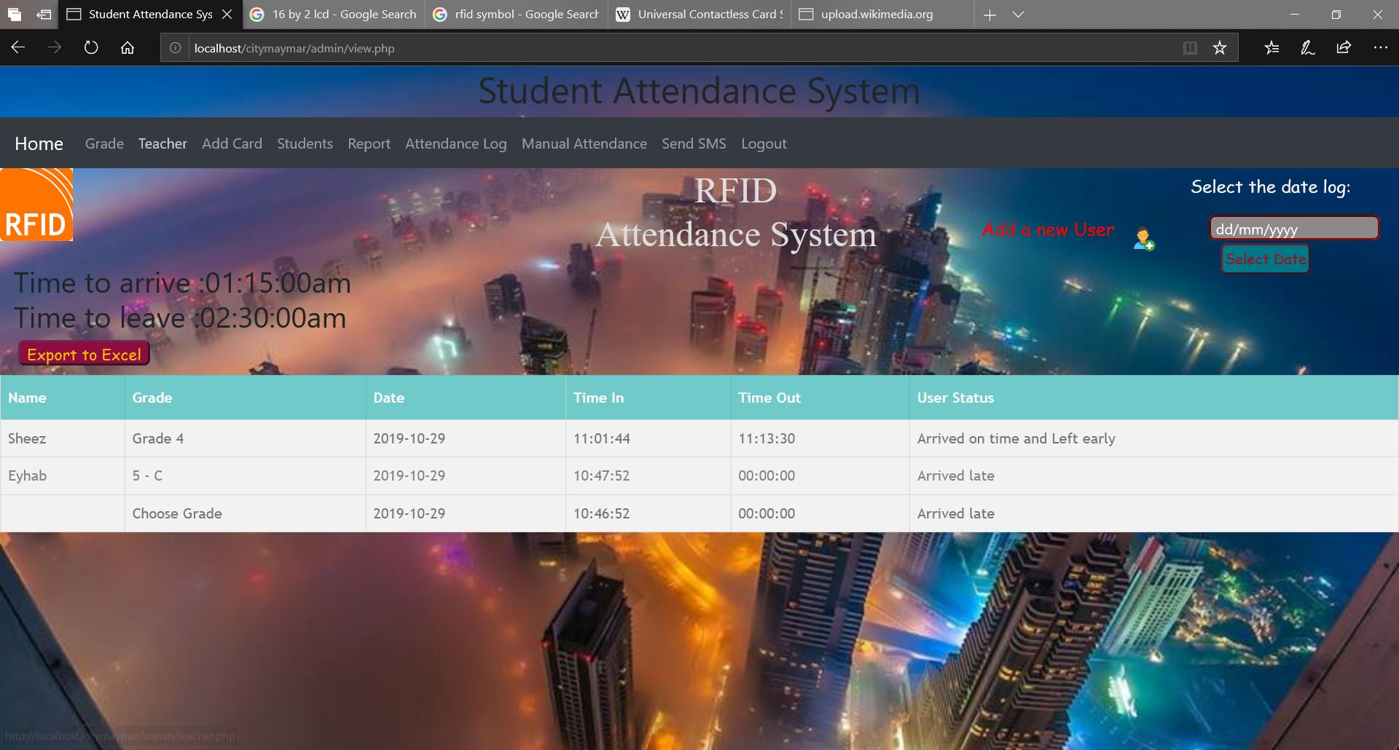
Real-time Monitoring
City School Head Office
Real-time Attendance Data
Internet
Attendance Report
Maymar Campus
Branch ‘n’
IoT (Internet of Thing) RFID Device
Web Application
IoT (Internet of Thing) RFID Device
Web Application

Slide 19
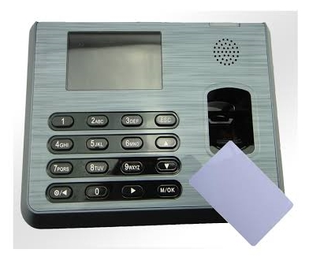

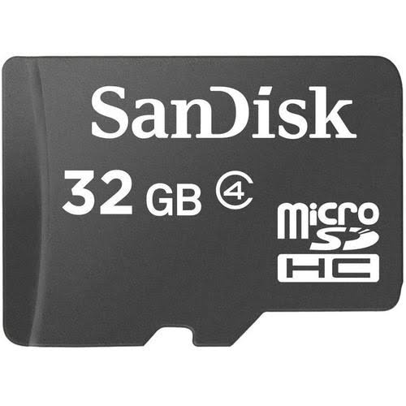



Comparison
Existing RFID Device
No Connection
Automated Online
Teachers Student Data
RFID (Online)
IoT Webserver, SQL, SMS
Apache, SQL Server
(School Attendance Management)
‹#›

Slide 20
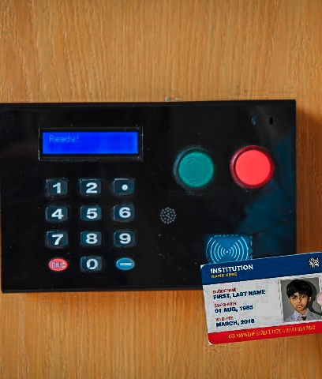
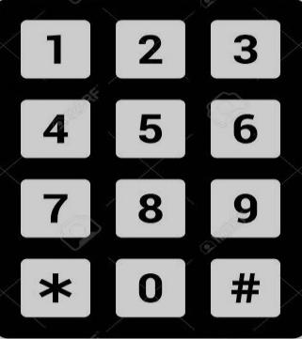
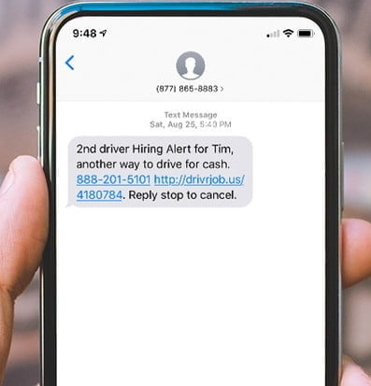
Key Features
Areeb Saleem
Arrived Late
Automated SMS Notification to parents
3
Sends SMS messages to parents for student absences and late arrivals
Dear Parents, Your child Areeb Saleem has arrived school Late
Time in 8:35 am.
Sent from The City School. Reply stop to cancel.

Slide 21
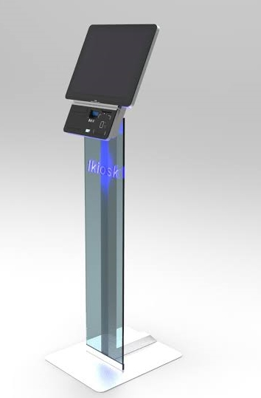
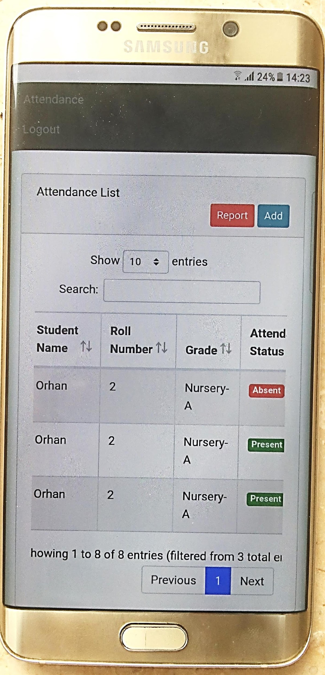
Key Features
Add attendance
Grade: Nursery
Date:
Manual Attendance
In case a student forgets his/her RFID card, Admin or Class Teachers enter student’s attendance.
For Teachers/ Manual Attendance
Kiosk - Admin Office

Slide 22
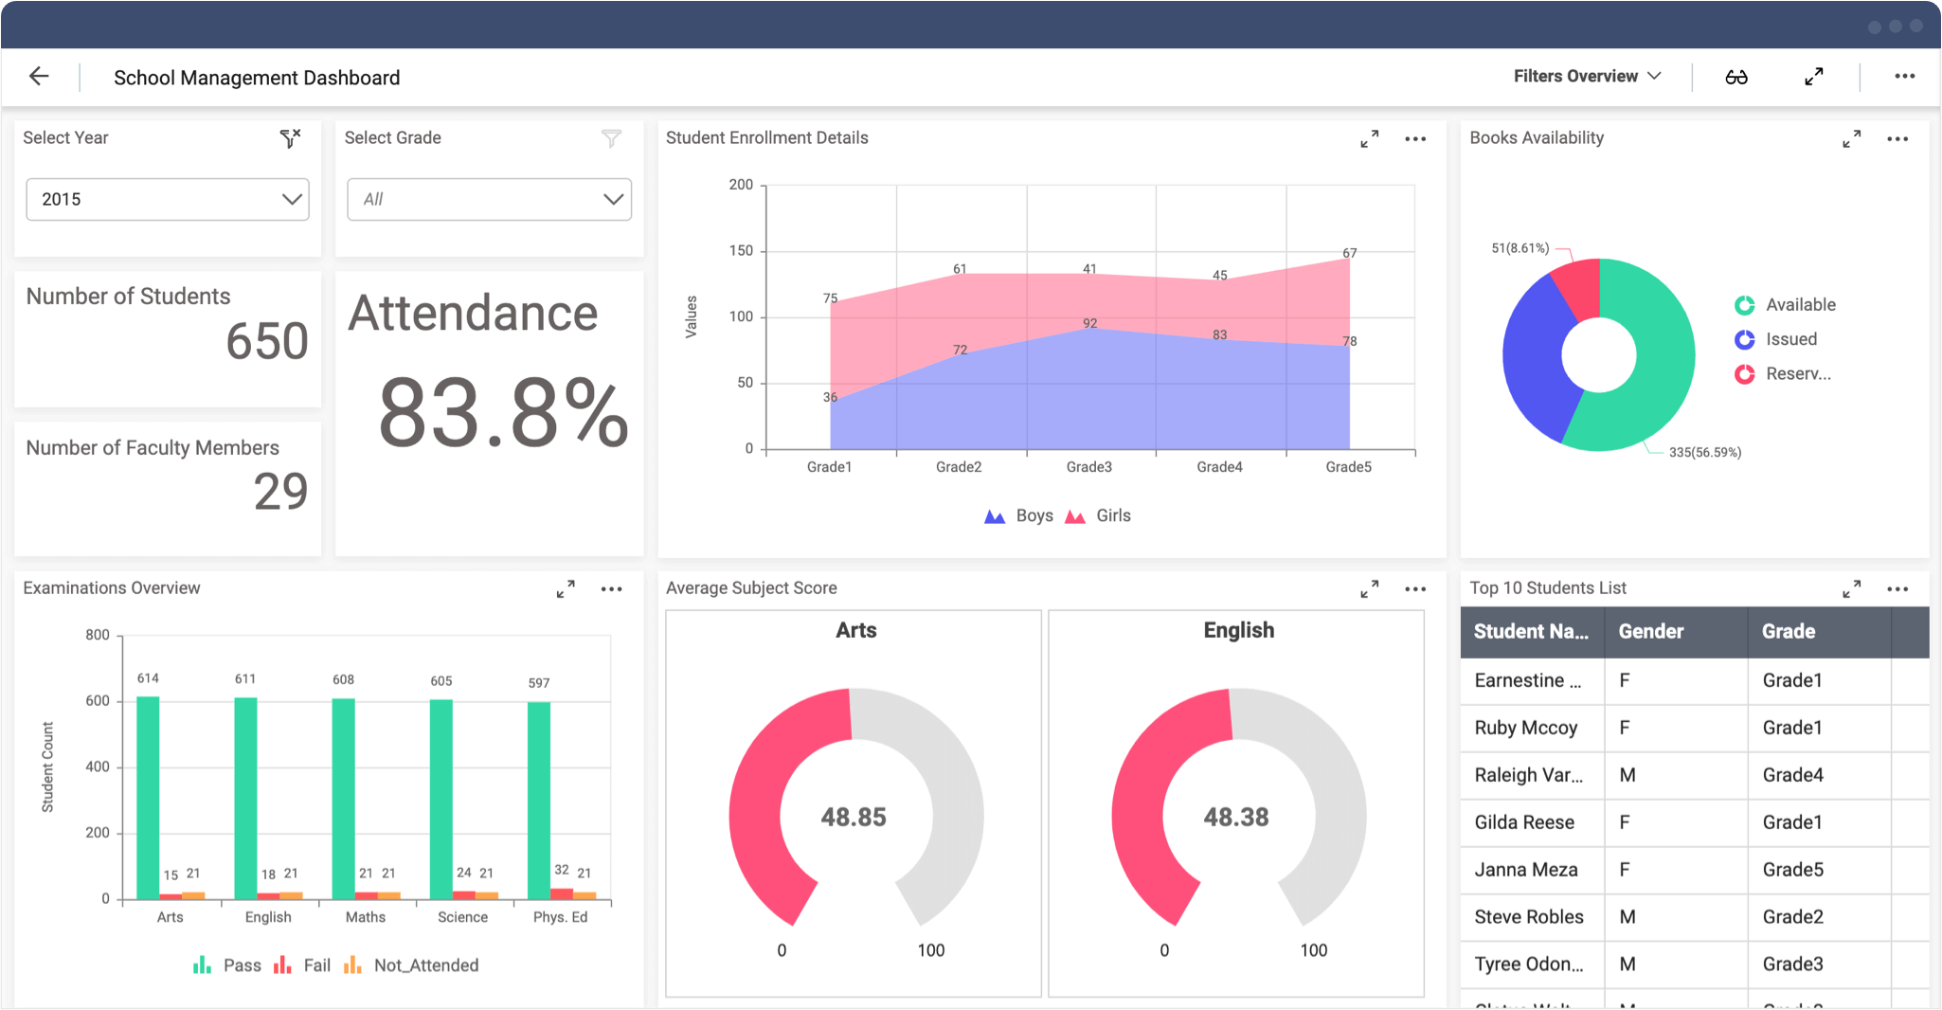
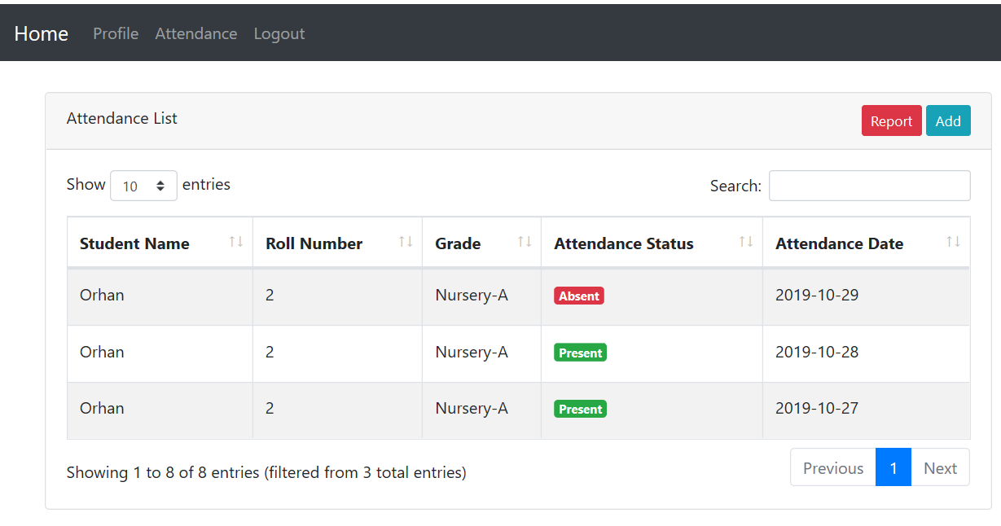
Key Features
Admin Dashboard
Teacher’s & Admin Login Accounts
Individual dashboards for Teachers and Administration
Teacher’s Dashboard

Slide 23
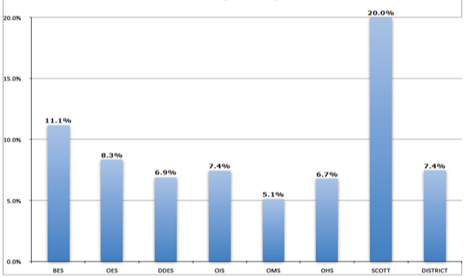
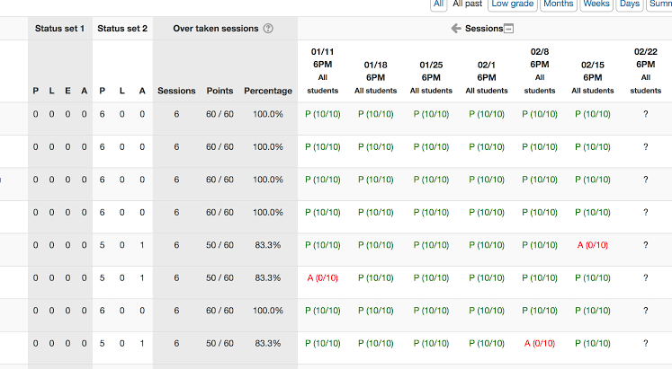
Key Features
Head of School/ Summarised
Automated Reports Generation
Daily, Weekly or Monthly Reports Generation
For Teachers/ Class Wise

Slide 24
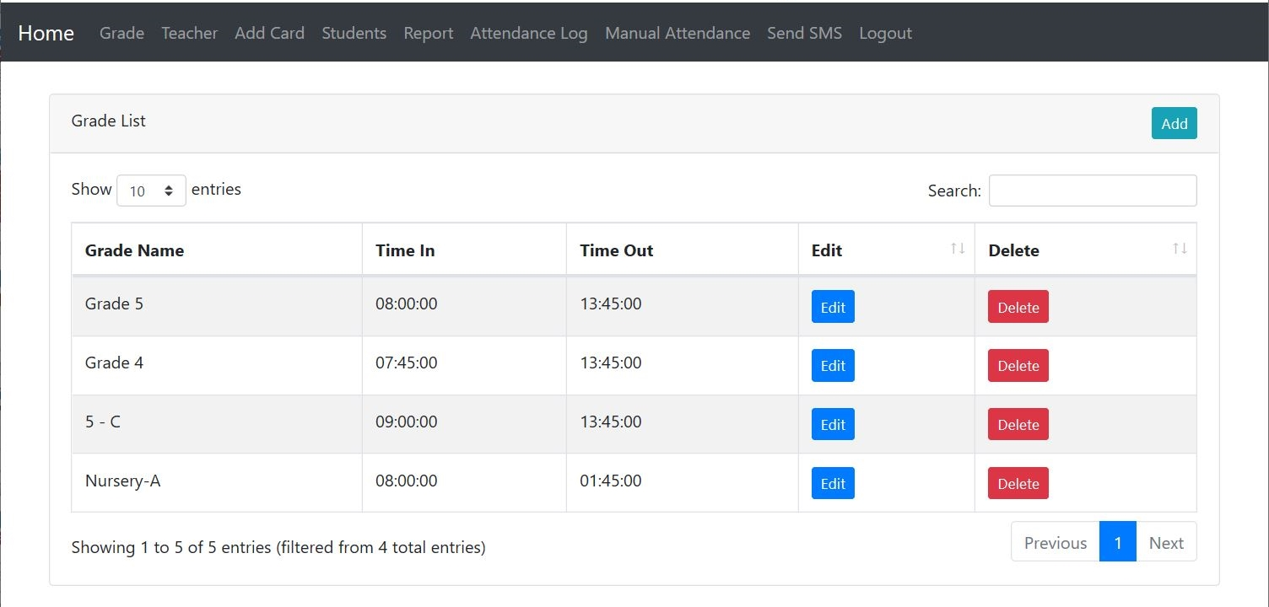
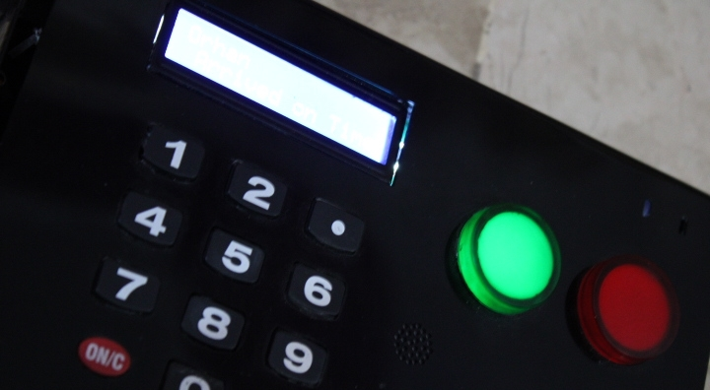
Visual indications at School’s Gate
Green Light <- Student Arrived on Time
Red Light <- Student Arrived Late
Muhammad Orhan
Arrived on Time

Slide 25
RFID Automated Attendance Log
Teacher’s App
Manual Attendance
Android Version

Slide 26
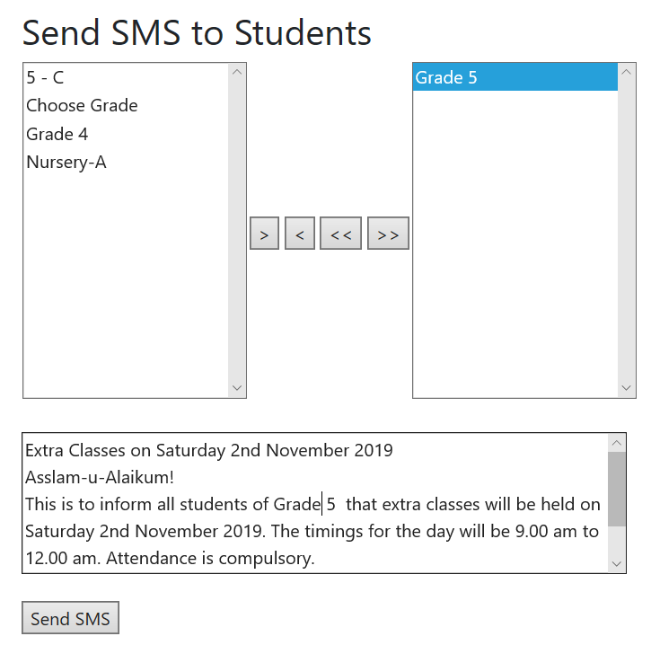
Generate SMS for whole Class & send on one click
Received SMS

Slide 27
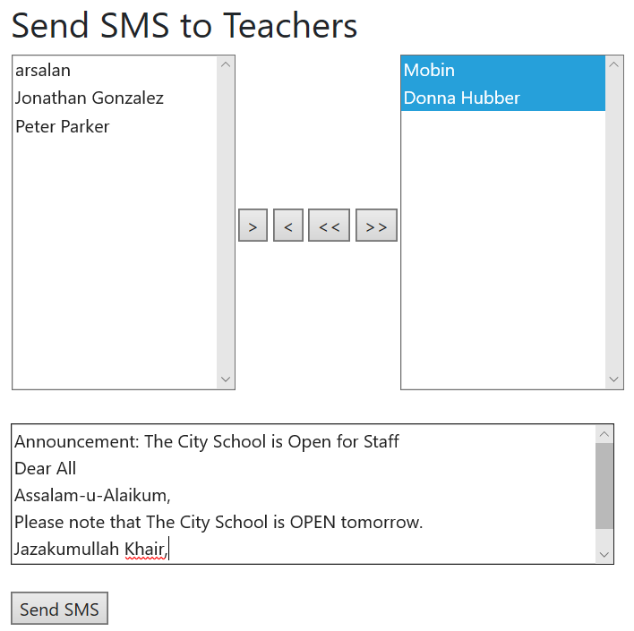
Generate SMS for Staff & send on one click
Received SMS

Slide 28

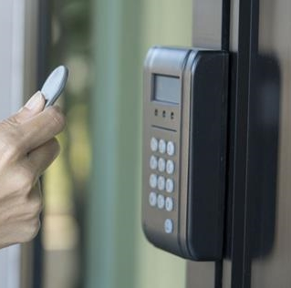
Models
Automated Online School Attendance Management System
RFID (Online)
IoT Webserver, SQL, SMS
RFID (Standalone)
SMS, SD Card
Walk Through
RFID

Slide 29

Thank You!
Muhammad Mobin

